Slide 1
Lecture 16
Image Document Formats

Slide 2
Bitmap vs. Vector Images
<circle
cx="10"
cy="10"
radius="4"
border="solid"
border-color="black"/>
Bitmaps do not generally scale to larger sizes very well
Vector Images are resolution independant
Bitmaps use more disk space and memory than vector images
Bitmaps are difficult to add metadata
Bitmaps display faster than vector images
Vector images are more flexible than bitmaps for manipulating
Bitmaps show much more true-to-life detail
Vector images are more difficult for programmers to support

Slide 3
Bitmap Image Formats
Bitmap/Raster image
  A simple information matrix describing the individual dots (pixels) that are the smallest elements of resolution on a display or printing device.
- monochrome (1 bit per pixel),
- 16-color (4 bits per pixel),
- 256-color (8 bits per pixel),
- TrueColor, 16 million color (24 bits per pixel), e.g., #FF00FF.

Slide 4
Bitmap Image Formats (contd.)
Windows Bitmap (.bmp) Format
  Supports TrueColor
  Not compressed
GIF (Graphics Interchange Format)
  Does not support TrueColor (up to 256 colors)
  Uses lossless compression

Slide 5
Bitmap Image Formats (contd.)
JPEG (Joint Photographic Experts Group)
  Supports TrueColor
  Compression at ratios up to 20 to 1
  Data is discarded during compression
    The compression method may degrade sharp detail in some images
PNG (Portable Network Graphics, .png) Format
  Supports TrueColor
  Uses lossless compression

Slide 6
Vector Image Formats
A vector image is a stored sequence of drawing commands which the computer can repeat to generate the image.
They contain simple drawing commands, such as line, rectangle, circle, arc, polygon.
They may also contain commands to set colors, fill areas, display text, and even include bitmaps.
Examples: Windows Metafile, PostScript, SVG

Slide 7
Scalable Vector Graphics (SVG)
An XML application standardized by W3C.
Vector Image Format
SVG benefits over traditional graphics
  Require considerably less bandwidth
  Resizable without loss of image quality
  May be scripted, searched, and dynamically created
To be supported by web browsers. Now requires a plug-in from Adobe.

Slide 8
Simple SVG Example
<?xml version="1.0" encoding="UTF-8"?>
<!DOCTYPE svg PUBLIC "-//W3C//DTD SVG 20010904//EN"
"http://www.w3.org/TR/2001/REC-SVG-20010904/DTD/svg10.dtd">
<svg width="600" height="300">
<g transform="translate(10 10)">
<g stroke="none" fill="lime">
<path d="M 100,200 L 300,400 H 20 Z">
</path>
</g>
</g>
</svg>
svg is the top XML element, with a coordinate system
g is used for (hierarchical) grouping
path is a general tool for geometry definition
  paths can be filled, stroked, ...
  paths can be transformed, animated, filtered, ...

Slide 9
More about SVG
Transformations can be defined on all elements
  • translate, scale, skewX and skewY, rotate
  • general 2x3 matrix
  • concatenation of all these (from right to left):
... transform="scale(2) rotate(20) translate(1,2) scale(4)" ...
Elements can be "grouped" in a g element
Groups
  • can be nested
  • can set transformations, attributes, etc,
    • inherited by their constituents
  • can be named, can be referred to in, eg, URL-s
  • can make the content more accessible
    • e.g., in browsers for visually impaired
  • make SVG code more readable

Slide 10
Two SVG examples…

Slide 11
1 <?xml version="1.0"?>
Root svg element defines sizes of displayable area and image
2
3 <!-- shapes.svg -->
4 <!-- Simple example of SVG -->
5
6 <svg viewBox = "0 0 300 300" width = "300" height = "300">
7
8 <!-- Generate a background -->
9 <g>
10 <path style = "fill: #eebb99" d = "M0,0 H300 V300 H-300 Z"/>
11 </g>
An CSS style that defines background color by filling area with color
12
13 <!-- Some shapes and colors -->
14 <g>
15 <circle style = "fill: green; fill-opacity: 0.5"
16 cx = "150" cy = "150" r = "50"/>
Define circle, rectangle and text
17
18 <rect style = "fill: blue; stroke: white"
19 x = "50" y = "50" width = "100" height = "100"/>
20
21 <text style = "fill: red; font-size: 24pt"
22 x = "25" y = "250">Welcome to SVG!</text>
23 </g>
24 </svg>

Slide 12
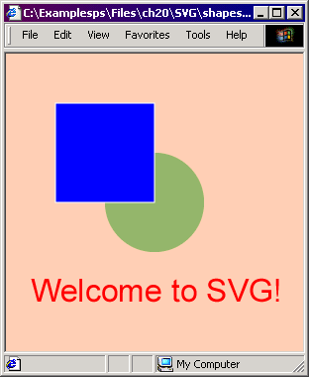
Output from shapes.svg

Slide 13
1 <?xml version = "1.0"?>
2
3 <!-- planet.svg -->
4
5 <svg viewBox = "-500 -500 1000 1000">
6 <g id = "background">
7 <path style = "fill: black" d = "M-2000,-2000 H2000 V2000 H-2000 Z"/>
8 </g>
9 <circle id = "sun" style = "fill: yellow" cx = "0" cy = "0" r = "100"/>
10 <g>
11 <animateTransform attributeName = "transform"
12 type = "rotate" dur = "80s" from = "0" to = "360"
13 repeatCount = "indefinite"/>
Define group-element animation attributes, so objects rotate 360 degrees in 80 seconds around origin
14 <circle id = "earth" style = "fill: blue"
15 cx = "400" cy = "0" r = "40"/>
16 <g transform = "translate( 400 0 )">
17 <circle id = "moon" style = "fill: white"
18 cx = "70" cy = "0" r = "10">
19 <animateTransform attributeName = "transform"
20 type = "rotate" dur = "20s" from = "360"
21 to = "0" repeatCount = "indefinite"/>
22 </circle>
Sub-group inherits animation, but also animates moon to rotate around earth
23 </g>
24 </g>
25 </svg>

Slide 14
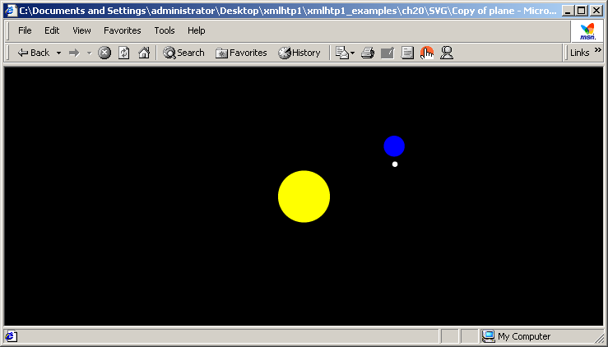
Output from planet.svg

